Slide 1
Federated Split BERT for Heterogeneous Text Classification
Team No: 11
Name: Tasnia Juha
ID: 20101486
ST: Sadiul Arefin Rafi
RA: Humaion Kabir Mehedi
Paper Presentation

Slide 2

Introduction
Key Focus:
Challenges of decentralized and heterogeneous data in NLP tasks
Proposing a novel framework, FedSplitBERT
Objectives of the Presentation:
Problem statement and Proposed solution
Analyze the methodology and findings
Implications and potential applications of FedSplitBERT

Slide 3
Why FedSplitBert?
What are the challenges of decentralized and heterogeneous data in NLP tasks?
Limitations of existing solutions, (FedAvg, FedProx, and FedAdam)

Slide 4
Heterogeneous Text Classification
Heterogeneous text classification refers to the task of classifying text data that comes different from sources or domains.
Traditional to approaches text classification often struggle with heterogeneous text data because they are designed to work well within a specific domain.

Slide 5
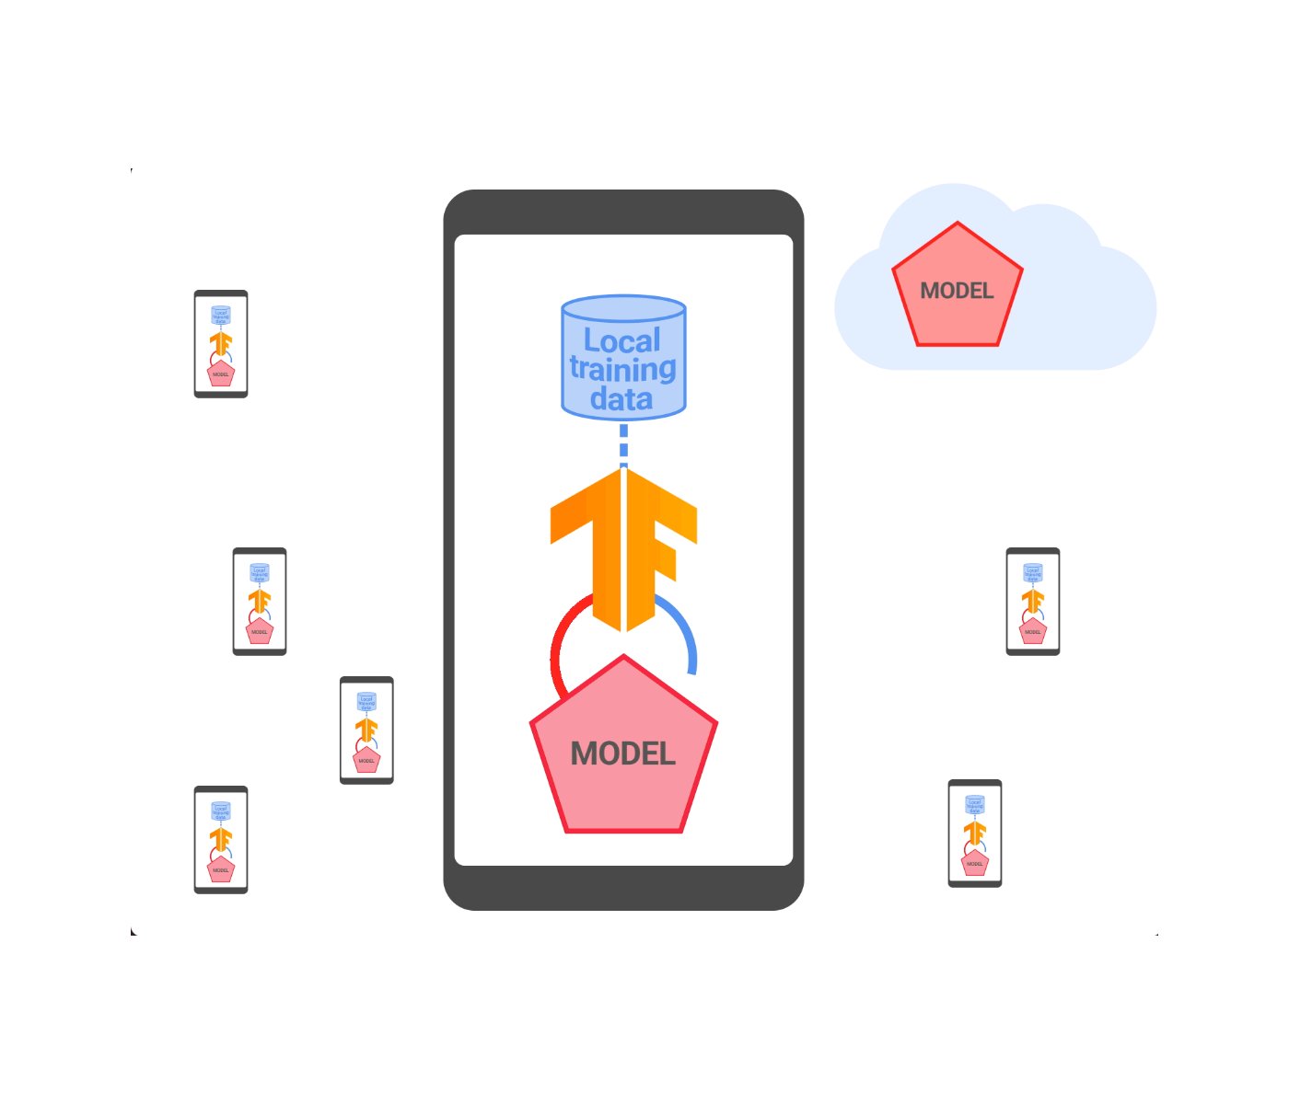
Federated Learning
Federated learning (FL) enables multiple clients collaboratively to train a global model while keeping the local data privacy.
FL works aim to decrease communication cost by splitting the whole model architecture into two parts: the local model and global model.

Slide 6
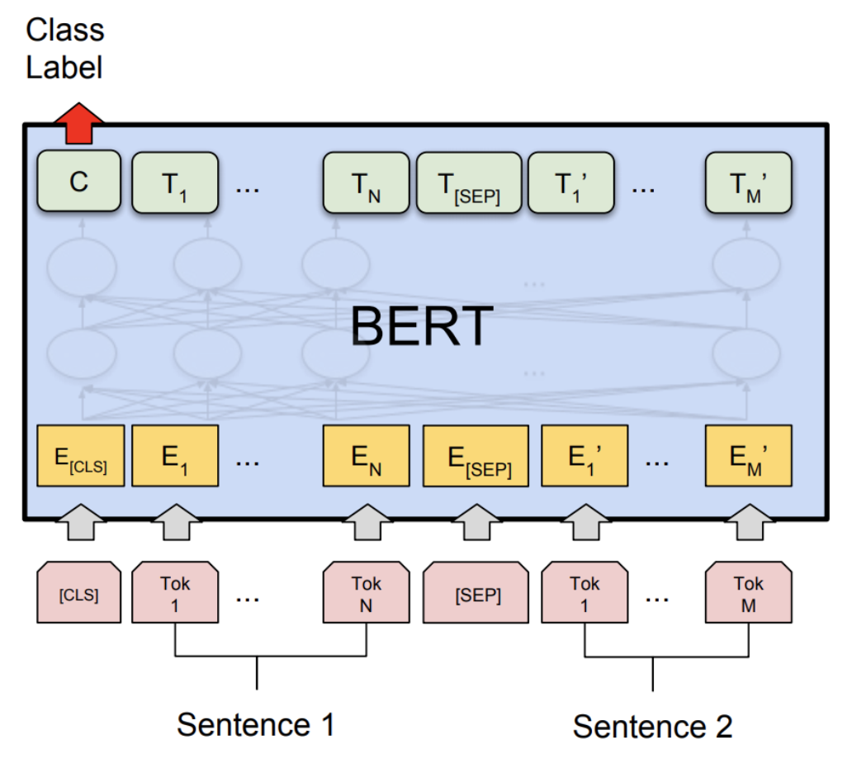
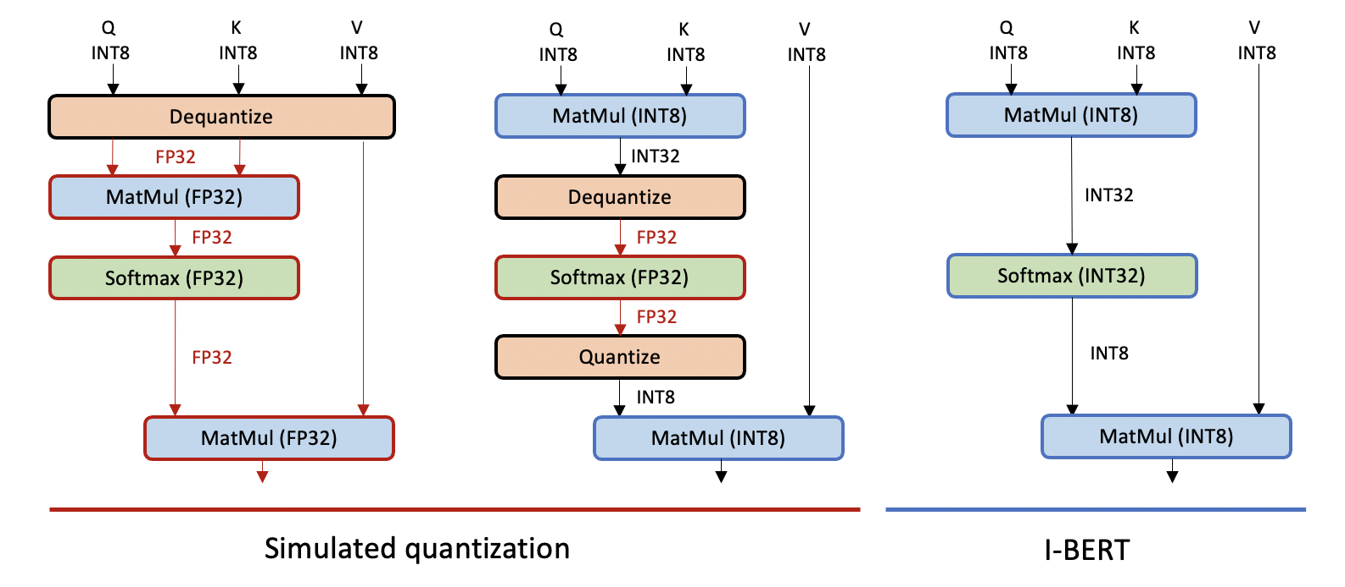
BERT and Quantization
BERT is a pretraining and fine-tuning framework .
Quantization reduces model size while maximizing performance.
However, how to fine-tune BERT on heterogeneous textual data remains under-explored.

Slide 7
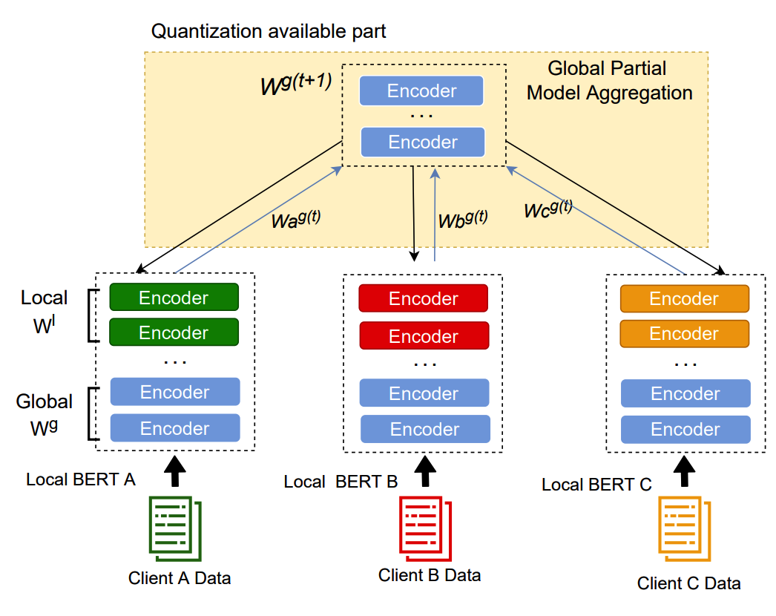
FedSplitBert
BERT architecture splits into encoder and classifier, trained on centralized server using Federated Learning.
FedSplitBERT improves communication efficiency by learning part of BERT layers locally and quantization.
Outperforms baseline methods (FedAvg, FedProx and FedAdam) significantly on all datasets

Slide 8
Conclusion
Future work on more NLP tasks with BERT in federated setting.
Reducing the communication cost due to the increasing size of NLP models.
Potential Applications of FedSplitBert.

Slide 9
Thank You

